Slide 1



Heart disease prediction
M. Pawan Aditya
P2-055

Slide 2
Problem statement
According to the statistics in US(united states of America) a persons dies for every 36 seconds , which is a very huge number so we have to be careful by being able to predict the percentage of occurring heart disease by some attributes which are tested in blood test , as we have huge data of these patient of having heart disease we have to study the data set with help of machine learning model to predict the heart disease percentage. ( dataset taken from Kaggle)

Slide 3
Attributes (blood test)
Age
Sex
chest pain type (4 values)
resting blood pressure
serum cholestoral in mg/dl
fasting blood sugar > 120 mg/dl
maximum heart rate achieved
the slope of the peak exercise ST segment
number of major vessels (0-3) colored by flourosopy
thal: 3 = normal; 6 = fixed defect; 7 = reversable defect

Slide 4
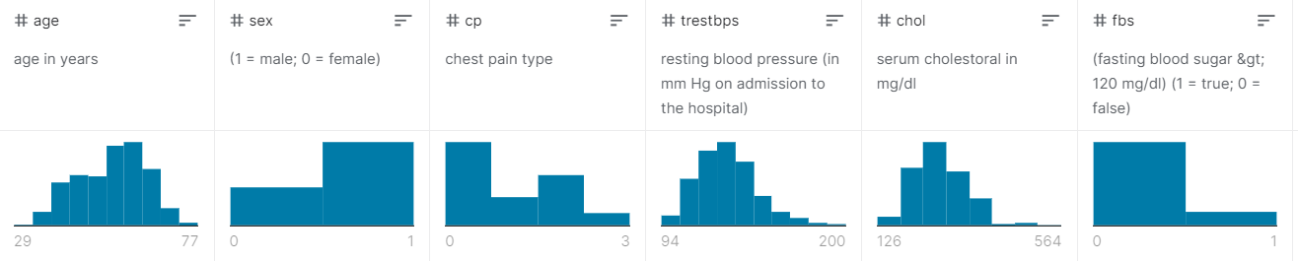
Study of the attributes

Slide 5
Observation from data
In the age attribute we can see it varies from 29-77 which is a numerical classification
In the sex attribute it is the categorical classification as male or female
The chest pain is also categorical classification as varies 0-3
Resting blood pressure range is 94-200 which is numeric classification
Cholesterol level ranges from 126-524
The fasting blood pressure is categorical as divided into two types less than 120 and greater than 120

Slide 6
Process of model creation
The data set from Kaggle has to be downloaded and add to the Jupiter notebook we export the pandas library to the notebook
after exporting the data set we check the data set for null values and the categorical attributes
The categorical attributes are converted to numerical scale as its best for training the model.
Then to selected the best algorithm for the model we use grid search cv library to find the best score

Slide 7
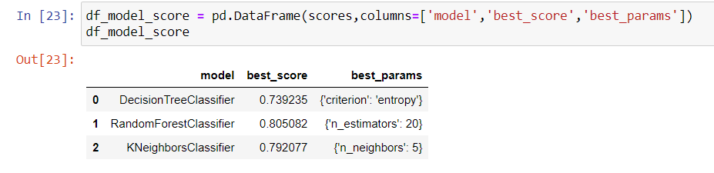
Selection of algorithm
As we can see the best accuracy is for the random forest classifier so we train our data model with this algorithm.

Slide 8
After the selection of the algorithm we train the model by splitting the data set into two sets as Test set and Train set .
after training the model with train data set we calculate the accuracy of the model by testing the predicted output with test data set.
We got the accuracy of 85.2459% .

Slide 9
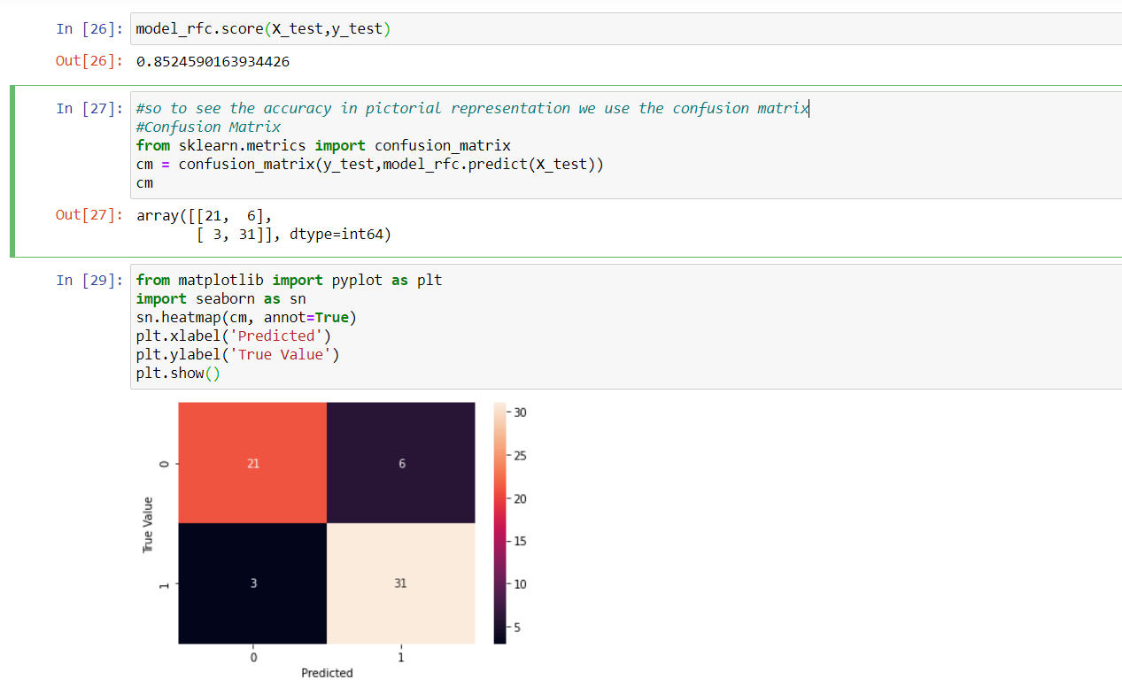
Accuracy

Slide 10
Matrix representation
So as to representation in confusion matrix we get the confusion matrix as
{ [ 21 , 6 ]
[ 3 , 31 ] }
We have 21 predicted correctly and 6 wrong
And in other 31 predicted correctly and 3 wrong

Slide 11
Thank you
谢谢

